Slide 1
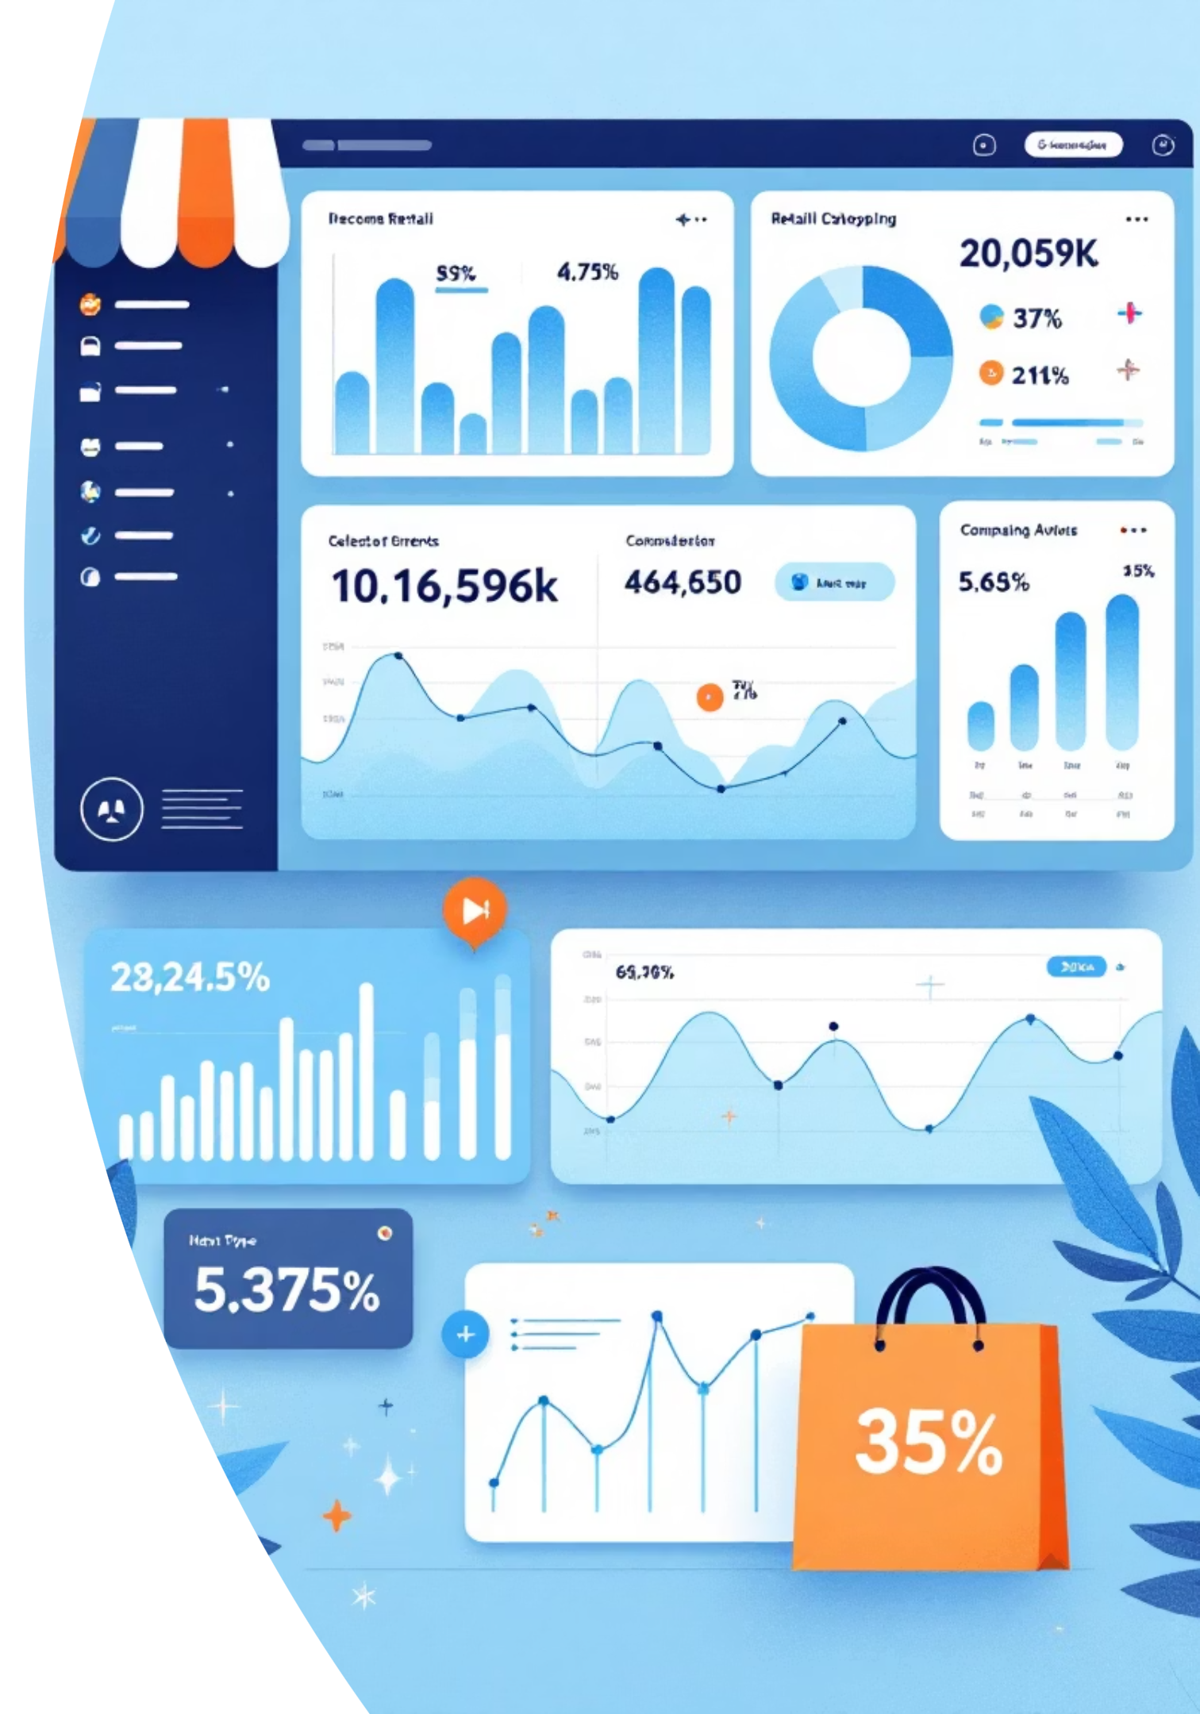
Customer Shopping Behavior Analysis
Uncovering insights from 3,900 purchases to drive strategic business decisions

Slide 2
Dataset Overview
3,900
18
$60
50
Total Purchases
Data Columns
Avg Purchase
Locations
Transactions analyzed
Features tracked
Per transaction
Geographic spread
Customer Data
Transaction Details
Age, Gender, Location
Product, Category, Amount
Subscription Status
Season, Size, Color
Purchase History
Discounts & Shipping

Slide 3
Data Preparation Journey
01
02
03
Data Loading
Missing Data
Feature Engineering
Imported dataset using pandas, explored structure with df.info()
Imputed 37 missing Review Ratings using median by category
Created age_group bins and purchase_frequency_days columns
04
05
Standardization
Database Integration
Renamed columns to snake_case, dropped redundant promo_code_used
Connected to PostgreSQL for SQL analysis

Slide 4
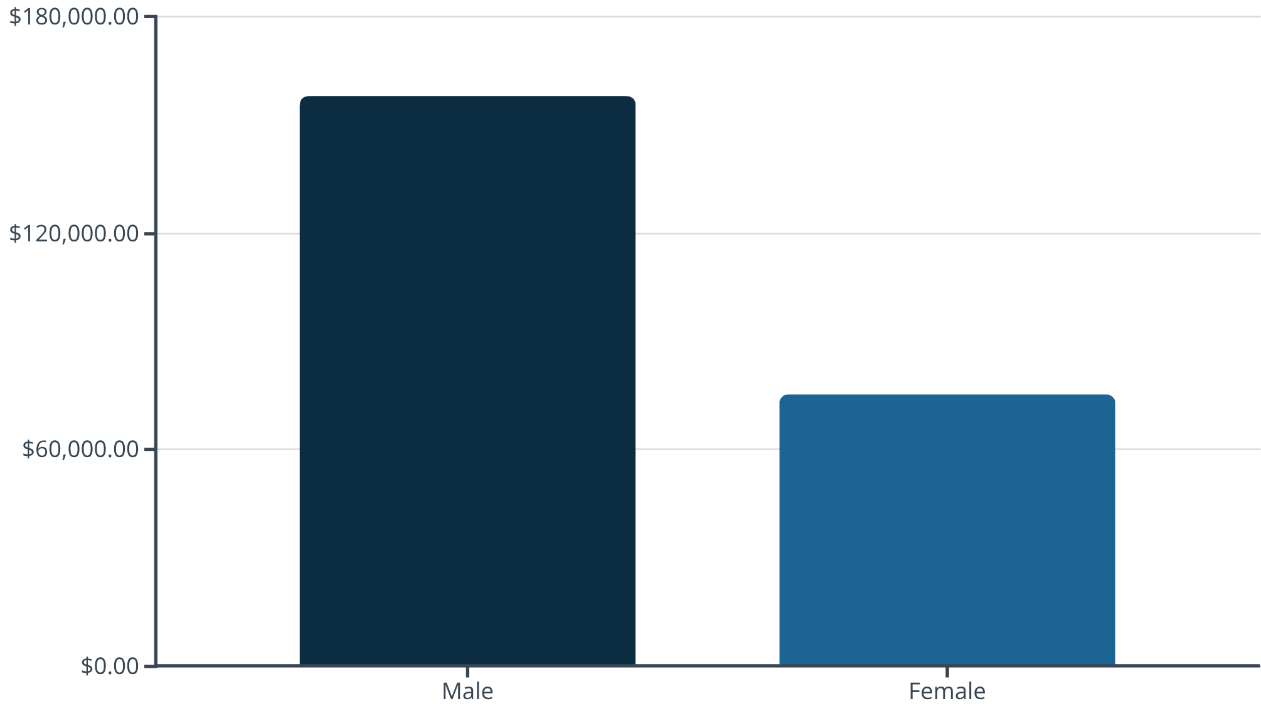
Revenue Insights
Gender Breakdown
Male customers generate significantly higher total revenue
Shipping Impact
Express: $60.48 avgStandard: $58.46 avg

Slide 5

Top-Rated Products
1
2
3
Gloves
Sandals
Boots
Rating: 3.86
Rating: 3.84
Rating: 3.82
4
5
Hat
Skirt
Rating: 3.80
Rating: 3.78

Slide 6

Subscription Analysis
Non-Subscribers
2,847 customers
Avg spend: $59.87
Total revenue: $170,436
Subscribers
1,053 customers
Avg spend: $59.49
Total revenue: $62,645
Repeat Buyers
Key Insight
Customers with 5+ purchases:
Similar spending patterns, but non-subscribers dominate volume
Subscribers: 958
Non-subscribers: 2,518

Slide 7






Discount Strategy Impact
50%
49.7%
49.1%
Hat
Sneakers
Coat
Highest discount rate
48.2%
47.4%
Sweater
Pants
High-Spending Discount Users: Many customers using discounts still spend above average ($60+), indicating discounts drive volume without sacrificing quality buyers

Slide 8
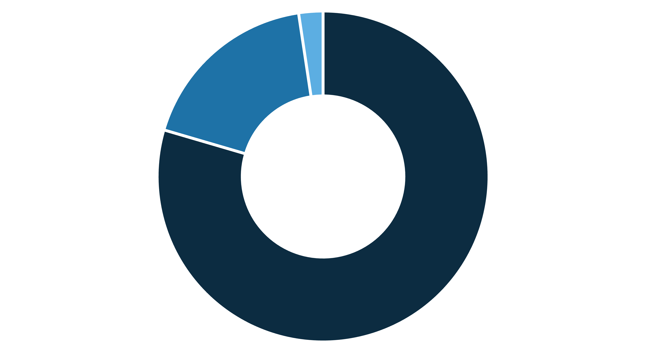
Customer Segmentation
Loyal
Returning
New
Loyal Customers
Returning
New
80% of customer base
18% showing repeat behavior
2% first-time buyers

Slide 9
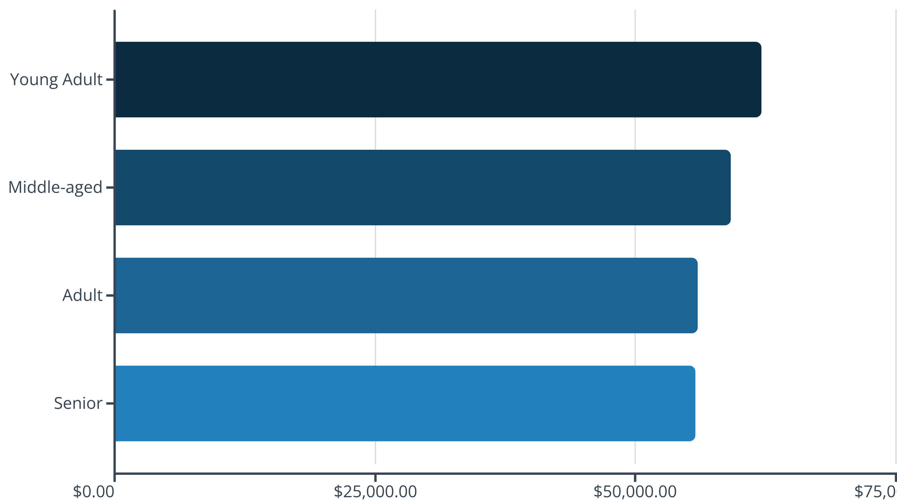
Age Group Revenue Distribution
Young adults lead revenue generation, followed closely by middle-aged customers. Relatively balanced distribution across all age groups.

Slide 10






Strategic Recommendations
Boost Subscriptions
Loyalty Programs
Optimize Discounts
Promote exclusive benefits to convert high-frequency buyers
Reward repeat buyers to strengthen loyal segment
Balance sales volume with margin control
Product Positioning
Targeted Marketing
Highlight top-rated items in marketing campaigns
Focus on young adults and express shipping users

